Slide 1

AI-Powered Customer Support Workflow
Jeffrey Daniel Rutley
AI Automation | Project 1

Slide 2
Introduction
Jeffrey Daniel Rutley
This project transforms a largely manual customer support workflow—characterized by slow intake, manual routing, and inconsistent prioritization—into an AI-assisted model that automates inquiry capture, ticket classification, and response support. By combining AI tools with human oversight for complex and sensitive cases, the improved workflow increases efficiency, speeds response times, and enhances overall customer satisfaction.

Slide 3
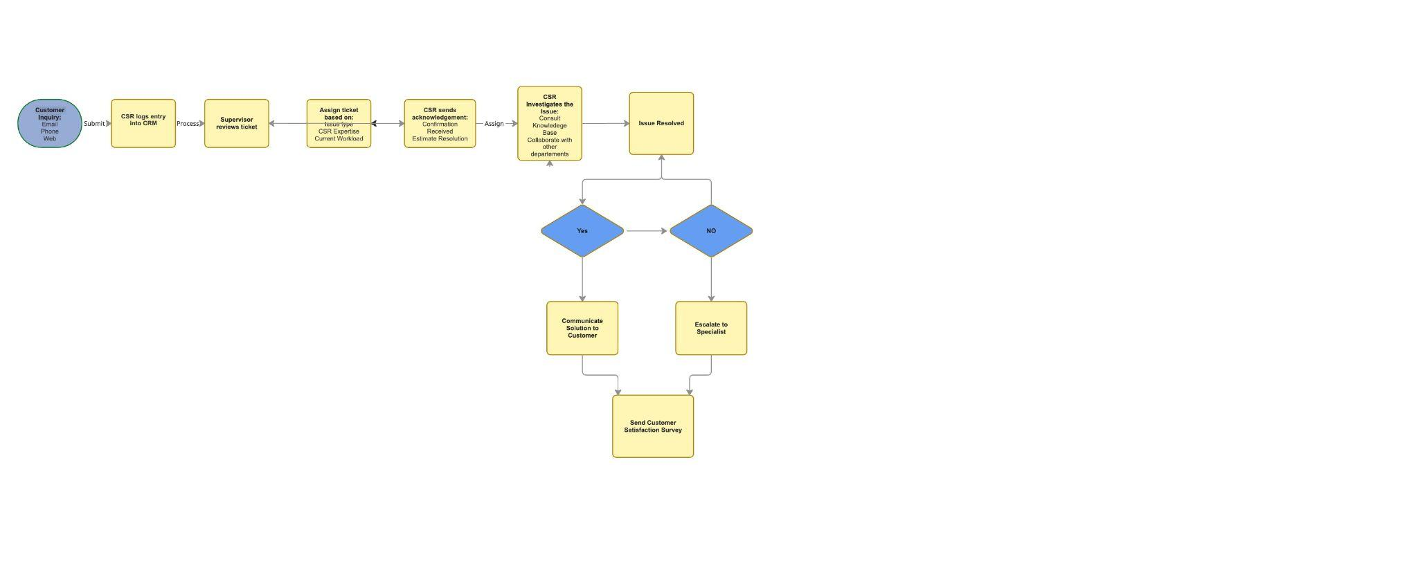
Current Workflow Overview

Slide 4
Key Problems Identified
Long Wait Times
Customers report being on hold for 30+ minutes before speaking to a representative. This indicates:
Bottlenecks during intake
Poor workload balancing
Insufficient routing prioritization
Multiple Transfers Between Representatives
Customers are being passed between multiple agents after already explaining their issue. This points to:
Poor initial issue classification
Misalignment between ticket type and CSR expertise
Late or inefficient escalation decisions
Issues Not Resolved on First Contact
Multiple complaints indicate issues weren’t resolved on the first call, requiring follow-ups.
Incomplete knowledge base access
CSRs lacking decision authority

Slide 5
Proposed AI integration
Suggested AI tools and how they fit into the workflow
1. Intake and capture
Intercom, Ada, Tidio, Zapier
2.Classification & routing
Salesforce Einstein, Freshdesk AI,
3.Resolution
Zendesk AI, Intercom
Expected benefits and improvements
Faster responses and ticket creation
Better prioritization and skill-based routing
Context aware suggestions and
Potential risks or limitations
Misrepresentation of customer intent
Incorrect prioritization
Inaccurate or outdated suggestions

Slide 6
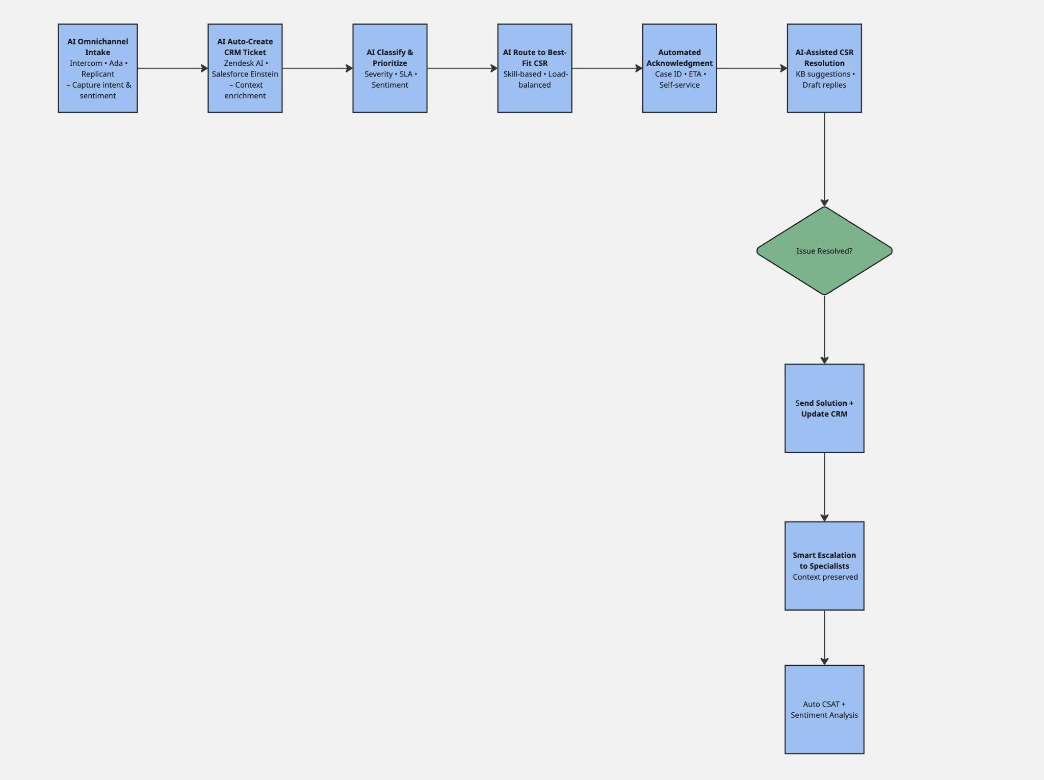
Updated Workflow with AI

Slide 7
Conclusion
This project demonstrates how integrating AI into a traditional customer support workflow can meaningfully improve efficiency, consistency, and customer experience without eliminating the need for human judgment. By thoughtfully redesigning the process to automate repetitive tasks while preserving human oversight for complex issues, the final workflow balances speed, accuracy, and empathy, providing a scalable and future-ready support model.

